Slide 1

Worked examples solving steady and time-evolving PDEs in FEniCS
Jakub Köry
Research Associate
jakub.koery@glasgow.ac.uk

Slide 2

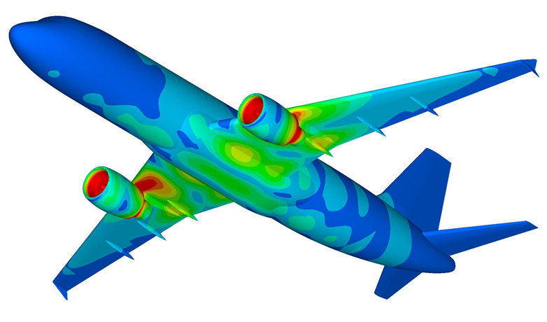
What is FEniCS?
Freely-available, open-source, automated computing environment for solving PDEs using FE method
https://fenicsproject.org/
Organized as a collection of components
Dolfin, FFC, UFL, FIAT, UFC
https://fenicsproject.org/citing/
Runs on a multitude of platforms
Windows, Linux, Anaconda, Docker
https://fenicsproject.org/download/
High-level Python and C++ interfaces
Very intuitive
Large community of users

Slide 3
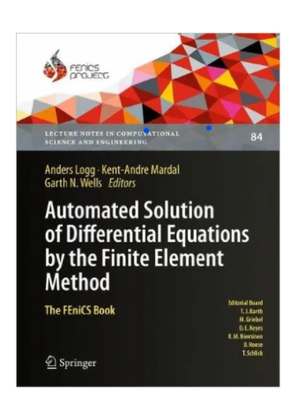
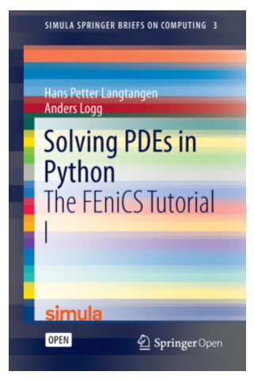
FEniCS documentation
Well-documented
https://fenicsproject.org/documentation/
The FEniCS book
“Automated solution of Differential Equations by the Finite Element Method” (2012)
Very detailed (~700 pages) presentation of the theory, software components and applications
Some examples might use outdated interfaces
First chapter still worth reading (~70 pages)
FEniCS Tutorial
“Solving PDEs in Python” (2017)
Great for new users who prefer Python
Explains
installation
the fundamentals of FEM
FEniCS programming
how to quickly solve a range of PDEs

Slide 4
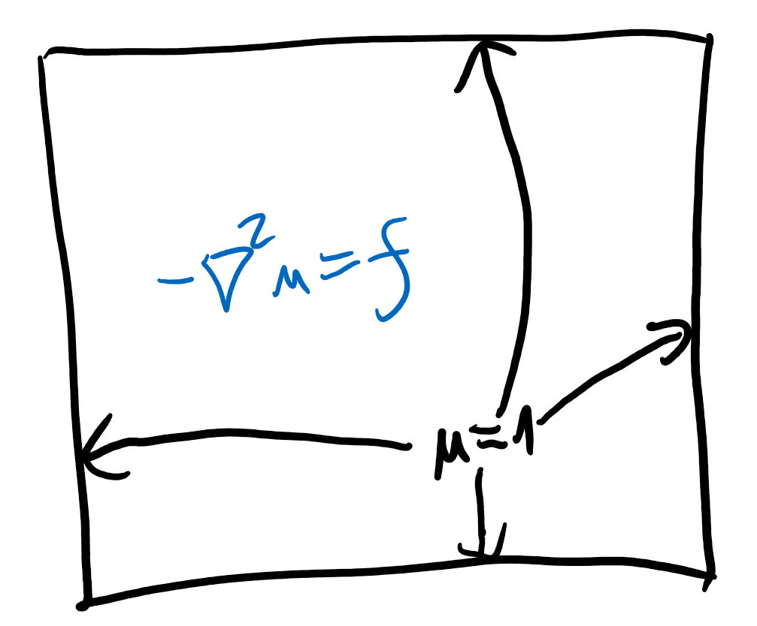
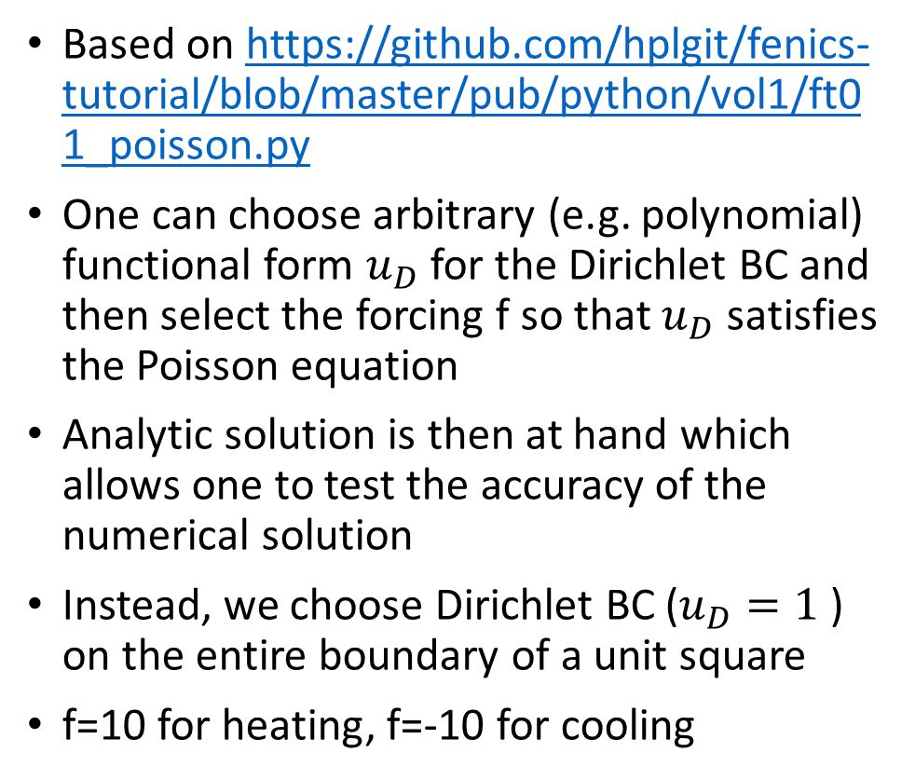
Simple example: Poisson equation in 2D
Based on https://github.com/hplgit/fenics-tutorial/blob/master/pub/python/vol1/ft01_poisson.py
One can choose arbitrary (e.g. polynomial) functional form $u_{D}$ for the Dirichlet BC and then select the forcing f so that $u_{D}$ satisfies the Poisson equation
Analytic solution is then at hand which allows one to test the accuracy of the numerical solution
Instead, we choose Dirichlet BC ($u_{D}=1$ ) on the entire boundary of a unit square
f=10 for heating, f=-10 for cooling

Slide 5
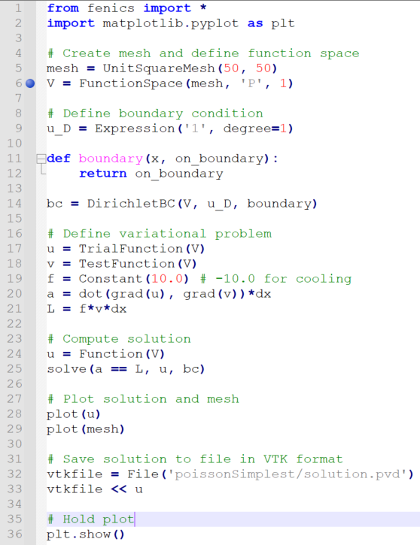
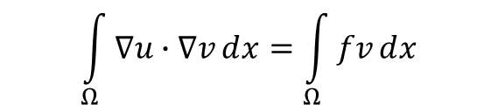
Poisson equation in 2D (implementation)
PoissonSquare.py
(in Notepad++)
Import all necessary functionality
Create a mesh and define the appropriate function space (without considering BCs)
‘P’ for standard Lagrange family of elements
1 for the degree of the finite element
Define the Dirichlet BC
Set up the variational problem
Weak formulation (Peter, Namshad):
Solve the problem
Post-processing
In terminal: “python PoissonSquare.py”
$$\int_{Ω}{∇u∙∇vⅆx=\int_{Ω}{fvⅆx}}$$

Slide 6
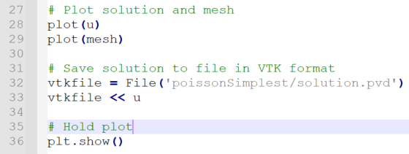
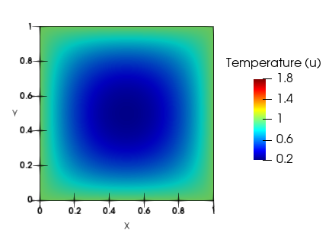
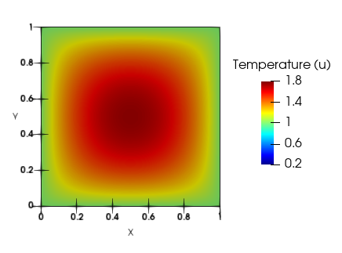
Post-processing
Direct plotting using matplotlib.pyplot
Export Vtk file
use Paraview/Visit to visualize it
Cooling (f=-10)
Heating (f=10)

Slide 7
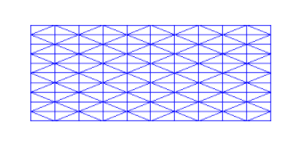
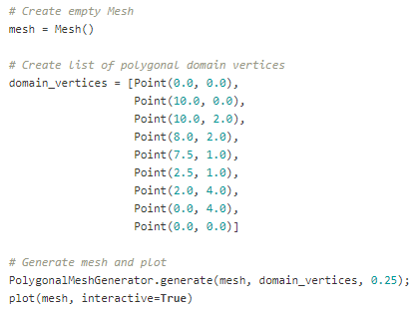
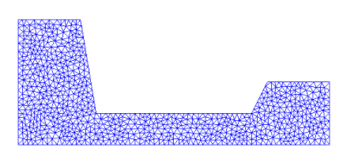
Mesh generation on simple domains
Simple built-in meshes
https://fenicsproject.org/olddocs/dolfin/1.3.0/python/demo/documented/built-in_meshes/python/documentation.html
UnitIntervalMesh, UnitSquareMesh, RectangleMesh, UnitCircleMesh, UnitCubeMesh, BoxMesh
Generate polygonal (2D) and
polyhedral (3D) meshes
https://fenicsproject.org/olddocs/dolfin/1.3.0/python/demo/documented/mesh-generation/python/documentation.html
PolygonalMeshGenerator, PolyhedralMeshGenerator
mesh = RectangleMesh(-3.0, 2.0, 7.0, 6.0, 10, 10, "right/left")
plot(mesh, title="Rectangle (right/left)")
interactive()

Slide 8
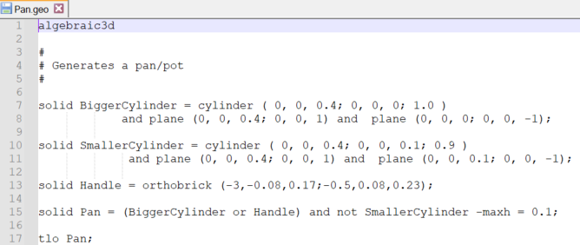
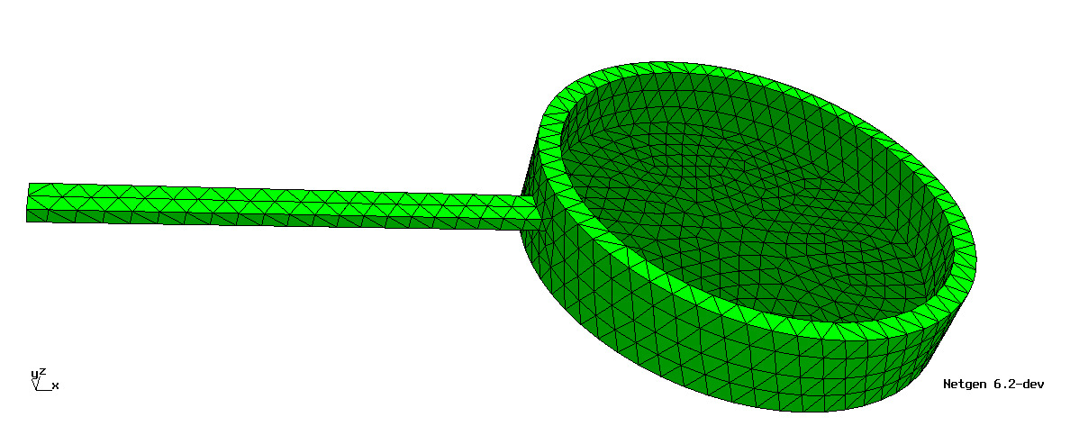
Advanced meshing: Importing a mesh
NetGen
Write a .geo file (describing the geometry of our domain using simple primitives - e.g. cylinders - and Boolean operations - complement, union and intersection)
Use NetGen to generate the meshed domain with a specified maximal mesh size, in the form of .msh file
Use DOLFIN-CONVERT (a python script) to convert the .msh file into an .xml file, which can be used as an input for FEniCS
Other external mesh generators (Liuyang)
Gmsh, TetGen, …
“In terminal: dolfin-convert Pan.msh Pan.xml”

Slide 9
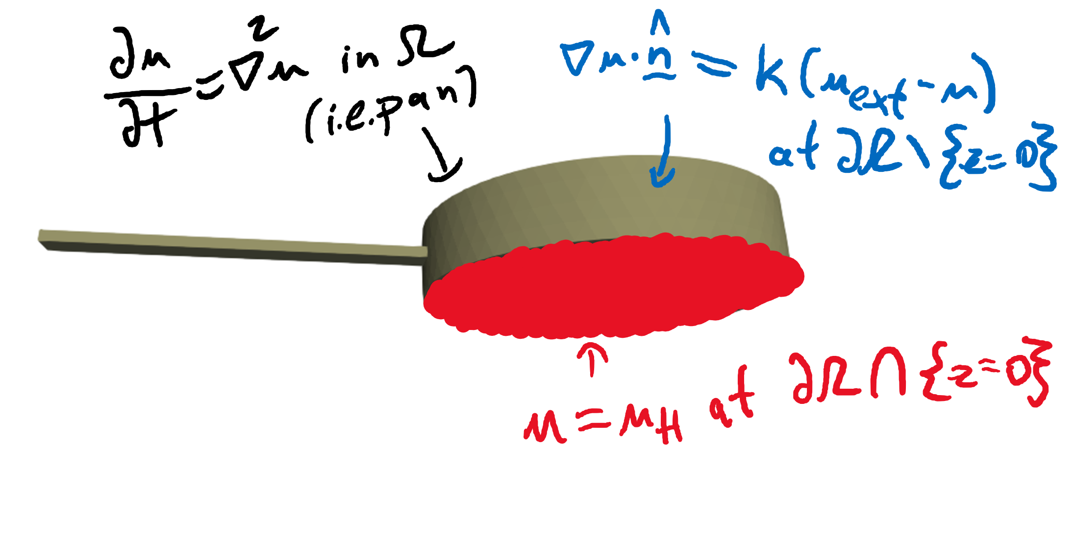
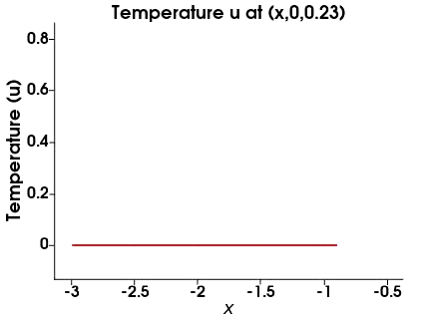
Time-evolving PDE
Thermal conduction in a 3D pan
Based on https://github.com/hplgit/fenics-tutorial/blob/master/pub/python/vol1/ft03_heat.py
Demonstrates advantages of FE over FD
domain geometry is nontrivial (irregular)
possible non-smoothness at the joint
Mixed boundary conditions
Dirichlet BC at the bottom of the pan
Fourier’s law (heat transfer) – Robin (third type) BC – at remaining boundary parts

Slide 10
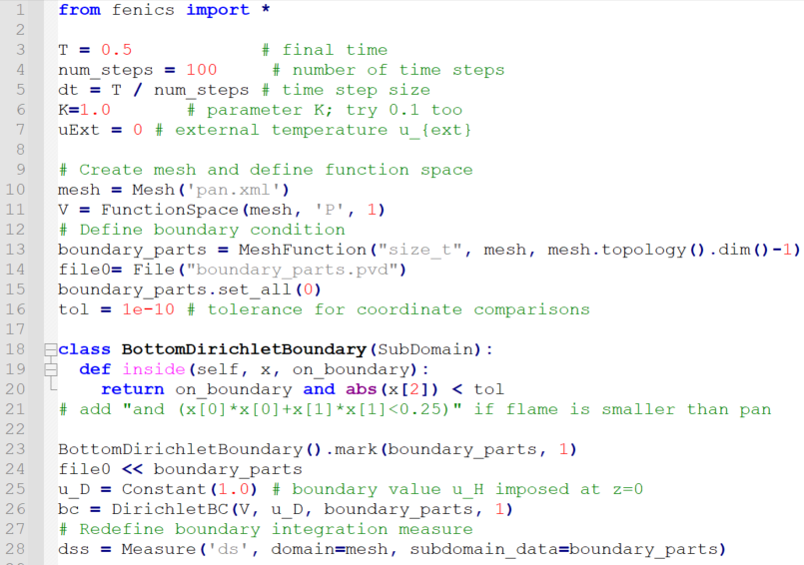
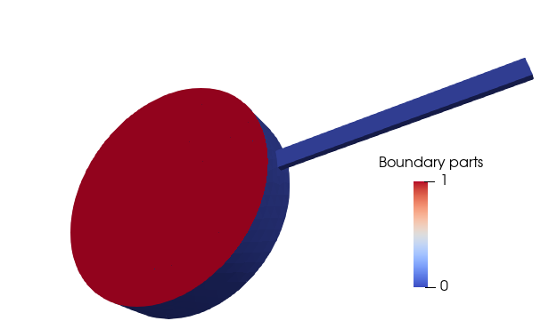
Importing the mesh and identifying the boundary parts
HeatOnPan.py (1st part)
Import all necessary functionality and define the key parameters
Import mesh and define the appropriate function space
Define and mark distinct boundary parts
Set Dirichlet BC at the bottom

Slide 11
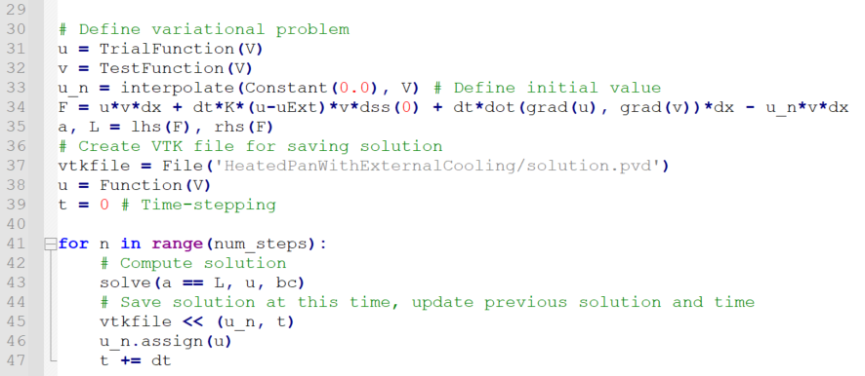
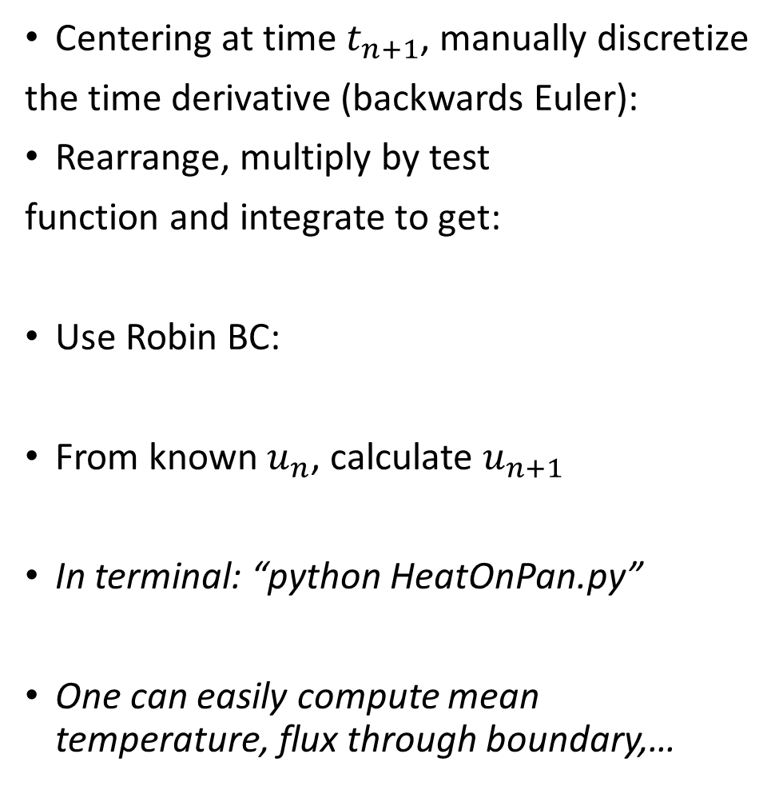

Heat equation with mixed BCs: weak formulation
Centering at time $t_{n+1}$, manually discretize
the time derivative (backwards Euler):
Rearrange, multiply by test
function and integrate to get:
Use Robin BC:
From known $u_{n}$, calculate $u_{n+1}$
In terminal: “python HeatOnPan.py”
One can easily compute mean temperature, flux through boundary,…
$$\frac{u_{n+1}−u_{n}}{Δt}=∇^{2}u_{n+1}$$
$$\int_{Ω}{u_{n+1}vⅆx −Δt\int_{∂Ω}{\left(∇u_{n+1}∙\hat{n}\right)v dS}+}Δt\int_{Ω}{\left(∇u_{n+1}∙∇v\right)ⅆx−\int_{Ω}{u_{n}vⅆx=0}}$$
$$\int_{Ω}{u_{n+1}vⅆx+KΔt\int_{∂Ω\backslash \{z=0\}}{\left(u_{n+1}−u_{ext}\right)v dS}+}Δt\int_{Ω}{\left(∇u_{n+1}∙∇v\right)ⅆx−\int_{Ω}{u_{n}vⅆx=0}}$$
HeatOnPan.py (2nd part)

Slide 12
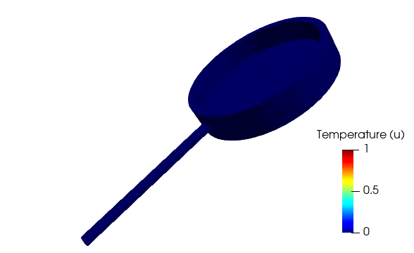
Post-processing in Paraview – the effect of K
K=1
K=0.1

Slide 13
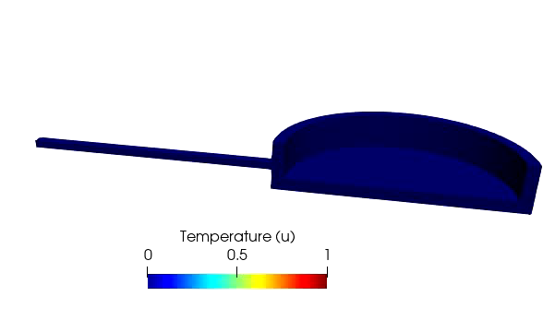
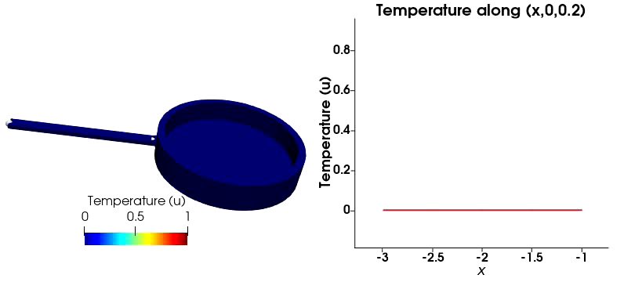
Clipped domain and plotting along a line in Paraview
Clipped domain
Plot along a line

Slide 14
Easy extensions (references w.r.t. Solving PDEs in Python)
Our heat equation example was based on Section 3.1
Two materials with different (thermal) properties - Section 4.3
Nonlinear problems – Section 3.2
Advection-reaction-diffusion equations – Section 3.5
Systems of PDEs
Elasticity – Section 3.3 (Hao)
Navier-Stokes – Section 3.4
Many others on https://fenicsproject.org/tutorial/

Slide 15
Thank you for your attention
If you have any questions, please do not hesitate to contact me at
jakub.koery@glasgow.ac.uk

